Slide 1
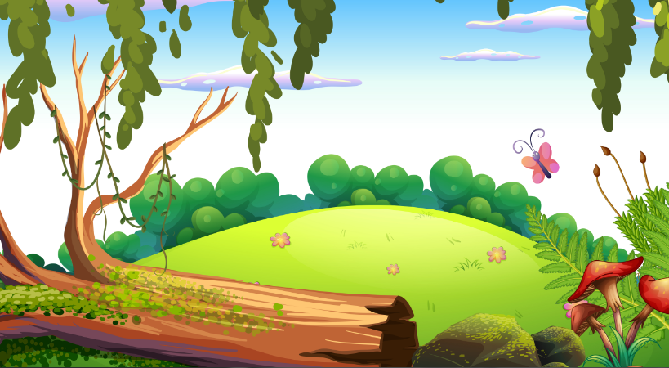
DANE ZAJC: VEVERICA PEKARICA
VIR SLIKE: https://www.vecteezy.com/vector-art/360687-a-nature-forest-background

